Slide 1
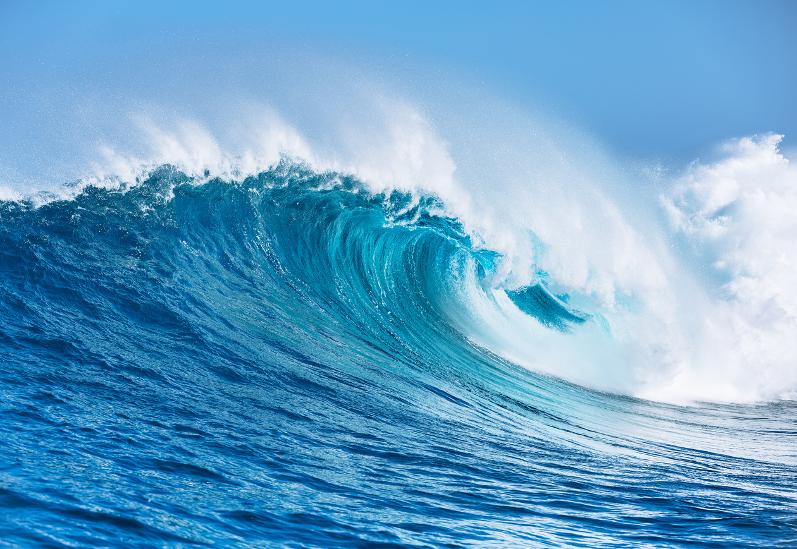
OCEAN STANCE
OUR OCEAN RESPONSABILITY

Slide 2
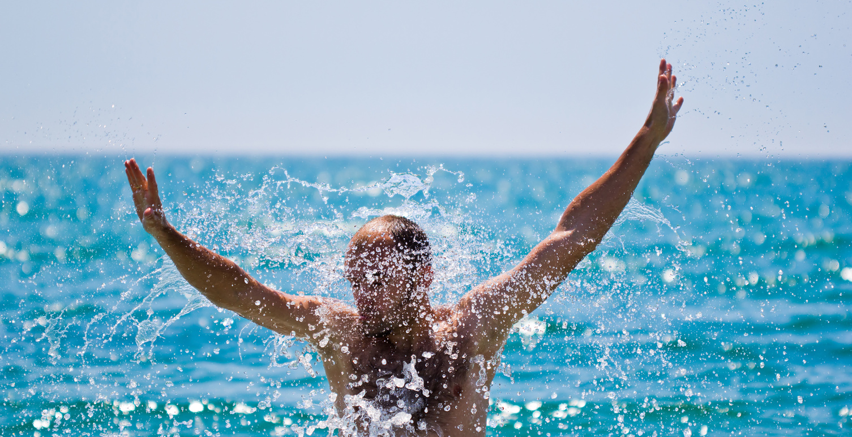
TAKE AN OCEAN STANCE
Our health depends on the health of the ocean
  If the ocean is sick, people get sick​
  If the ocean ‘dies’, most of the planet and most of us will die​
  All of us impact upon the ocean at home and at work​
  All of us can reduce this impact
“We only protect what we love, we only love what we understand, and we only understand what we are taught”
Jacques-Yves Cousteau​

Slide 3
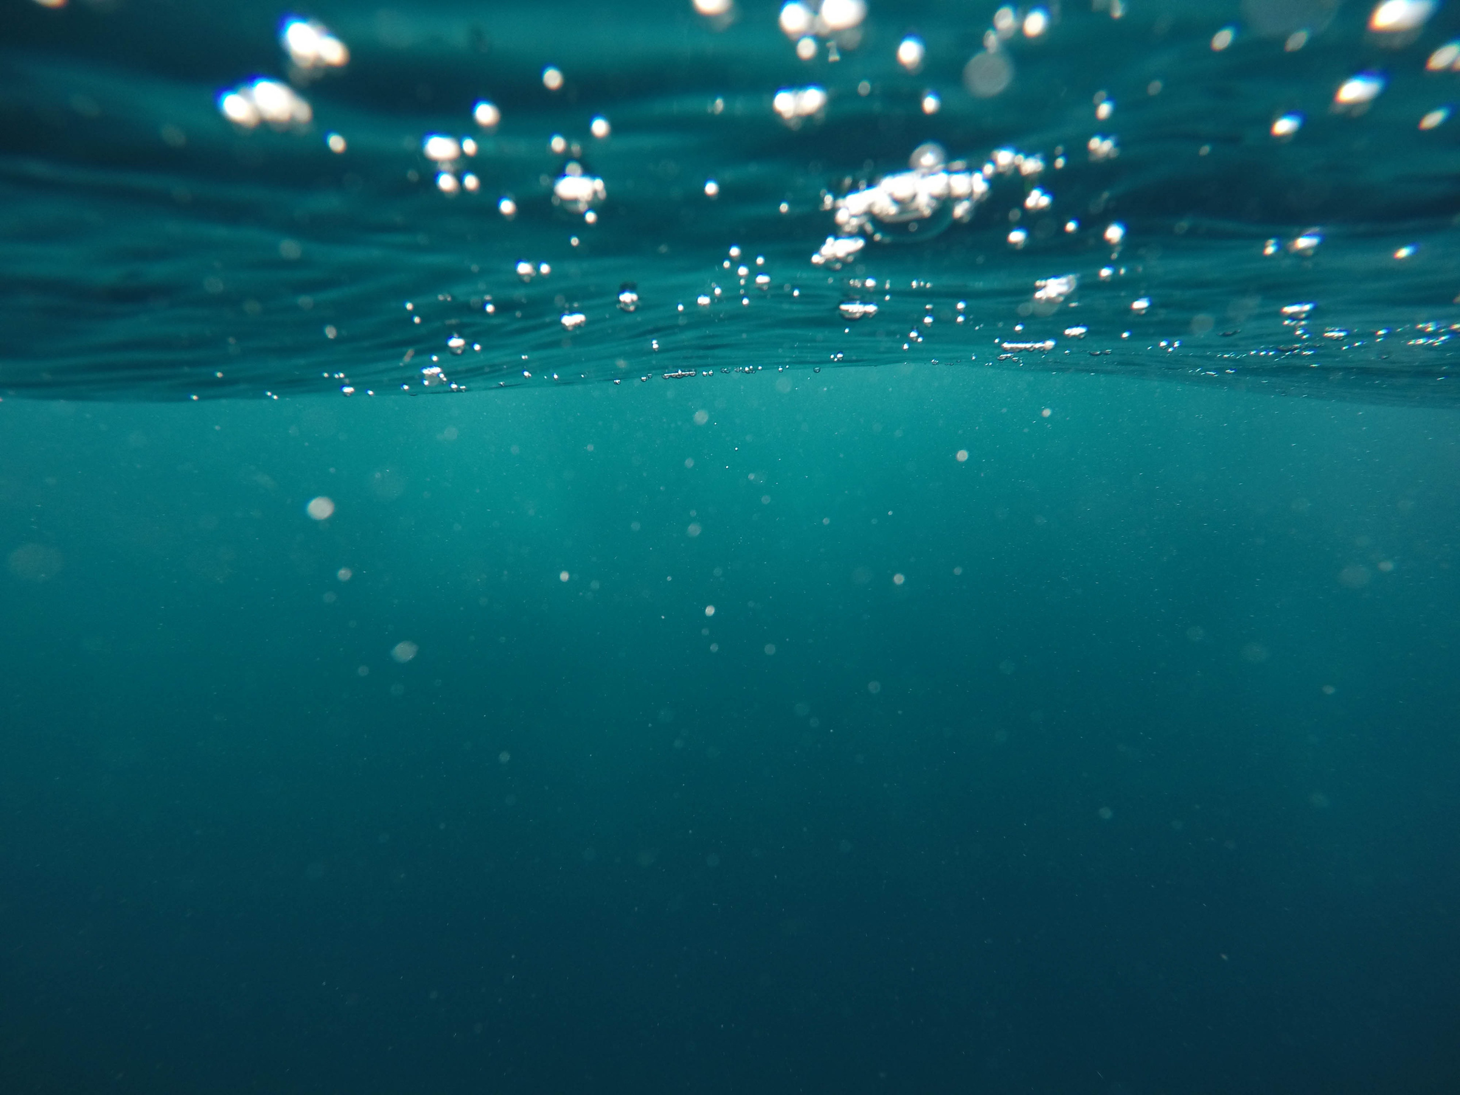
THE OCEAN
71%
Covers 71% earth’s surface​
50%
Produces at least 50% of oxygen​
97%
Contains 97% earth’s water​
90%
Absorbs 90% of planet’s excess heat​
99%
Provides 99% of living space​
40
Stores 40 trillion tonnes carbon
80%
Home to 80% of animal life​
30-50%
Absorbs 30-50% of CO2​
IT’S NOT TOO BIG TO FAIL!

Slide 4
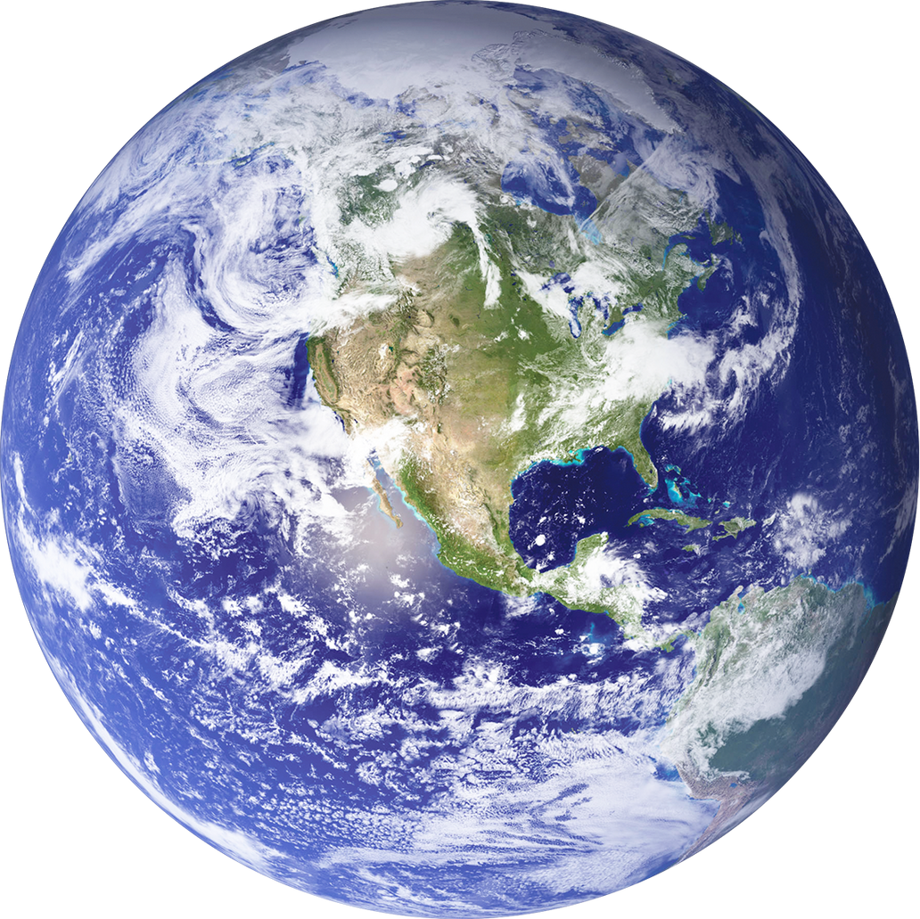
“How inappropriate to call this planet Earth when it is quite clearly Ocean”​
Arthur C. Clarke

Slide 5
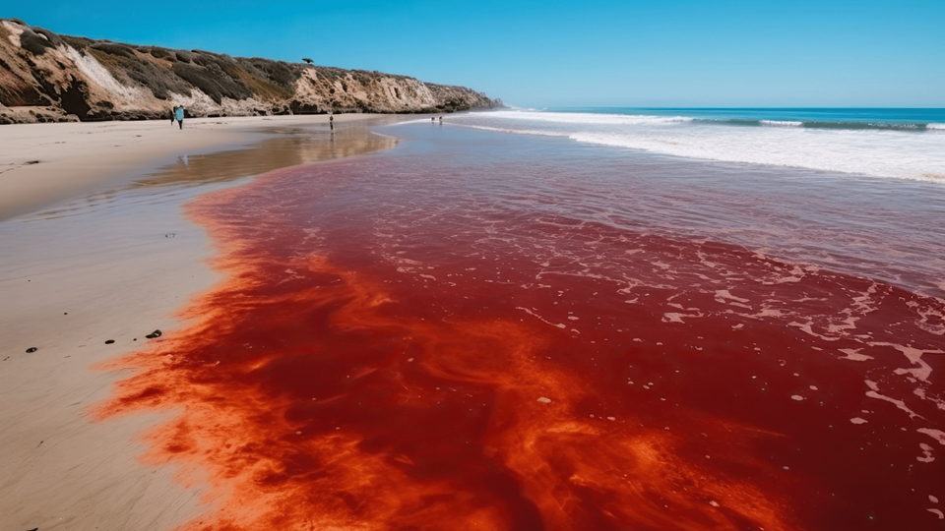
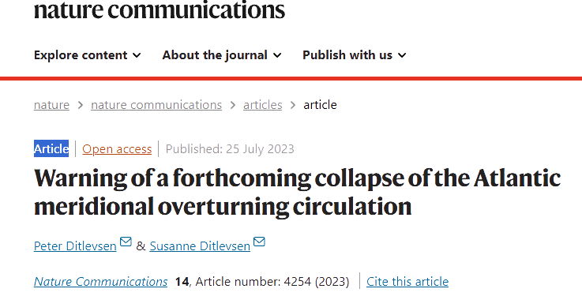
DEPENDENCIES
02
CLIMATE REGULATION
  Temperature moderation
  Extreme weather events
01
CARBON SEQUESTRATION
  Natural carbon sink
  Ocean acidification

Slide 6
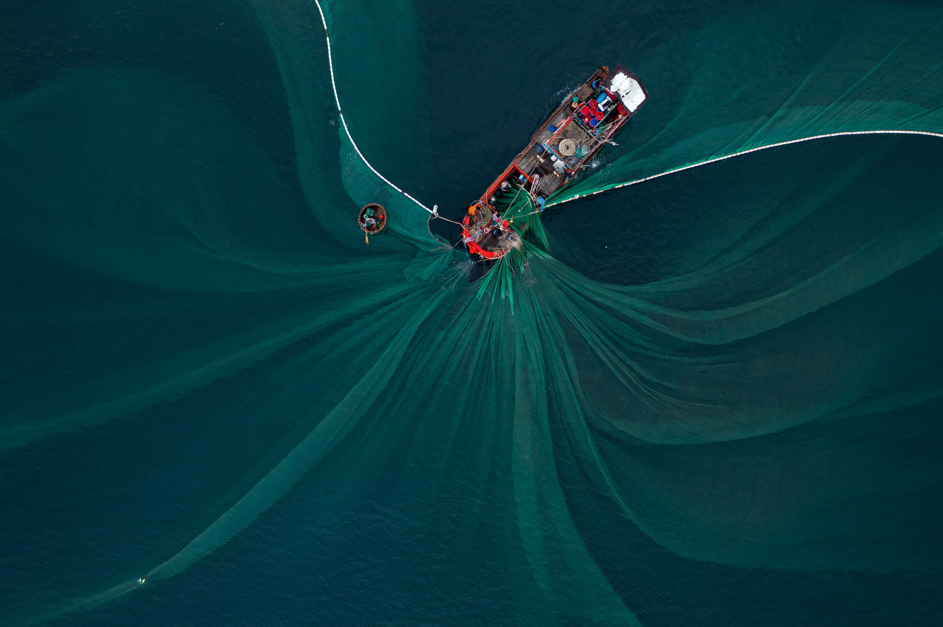
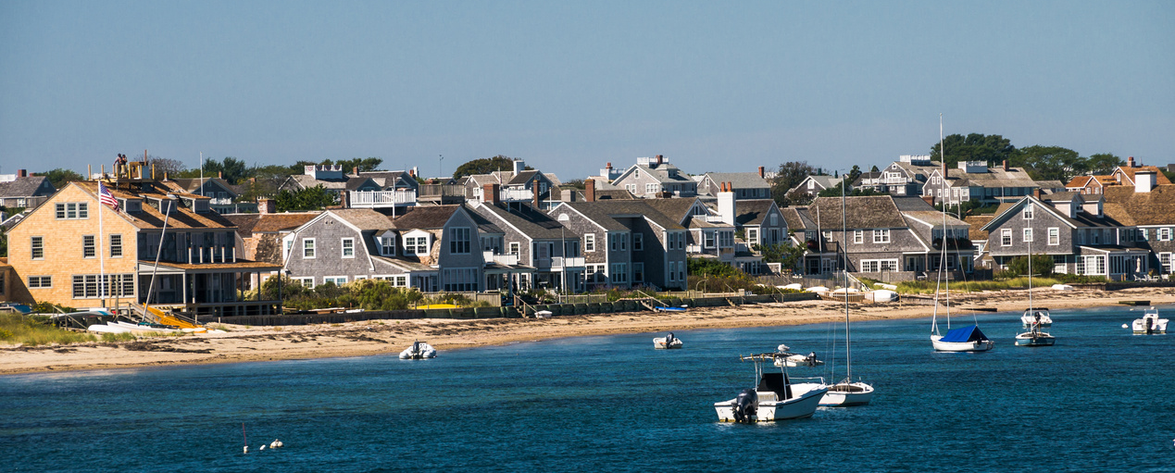
03
FOOD SECURITY
  Protein source
  Overfishing and unsustainable practices
04
MENTAL HEALTH AND WELLBEING
  Coastal living
  Recreational activities

Slide 7
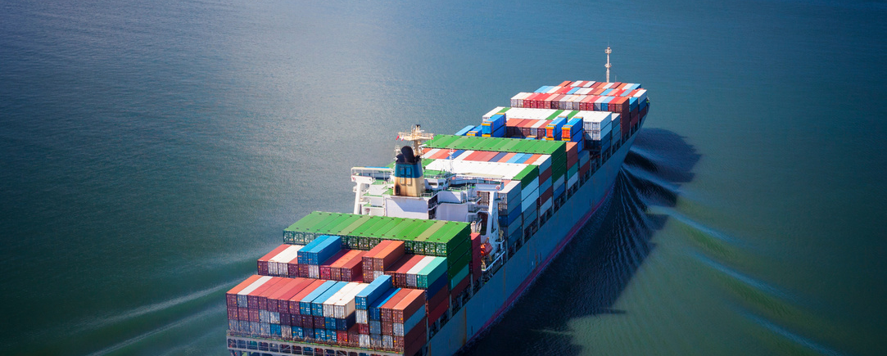
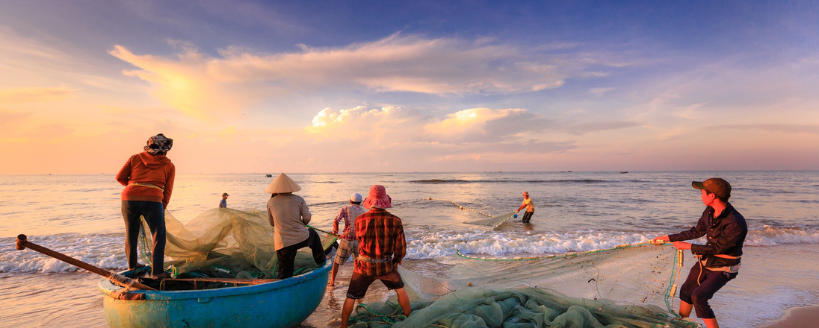
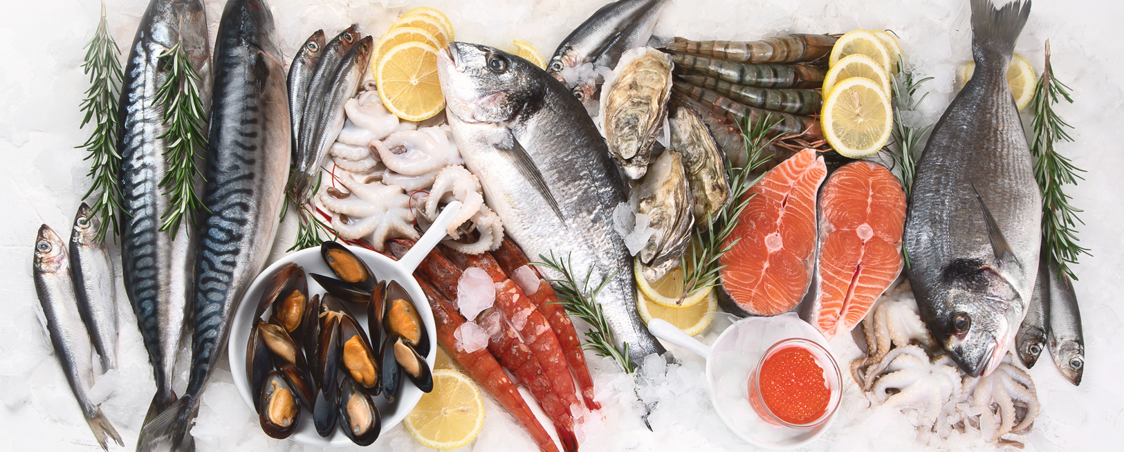
DEPENDENCIES
05
SUPPLY CHAINS
  Global trade
  Disruptions
06
LIVELIHOOD
  Economic driver
  Coastal communities
  tourism
07
PHYSICAL HEALTH
  Nutrition
  Disease transmission

Slide 8
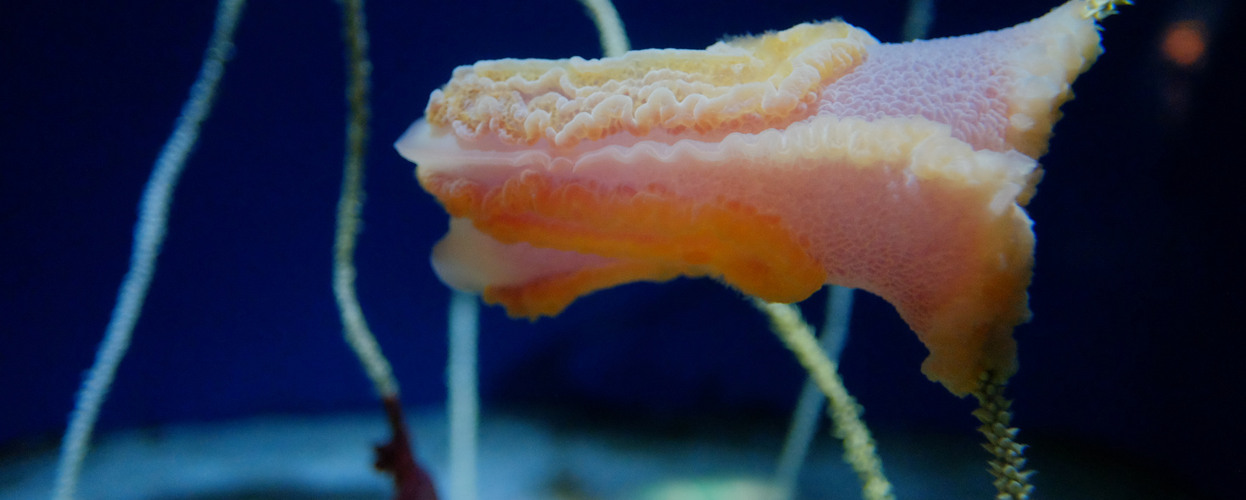
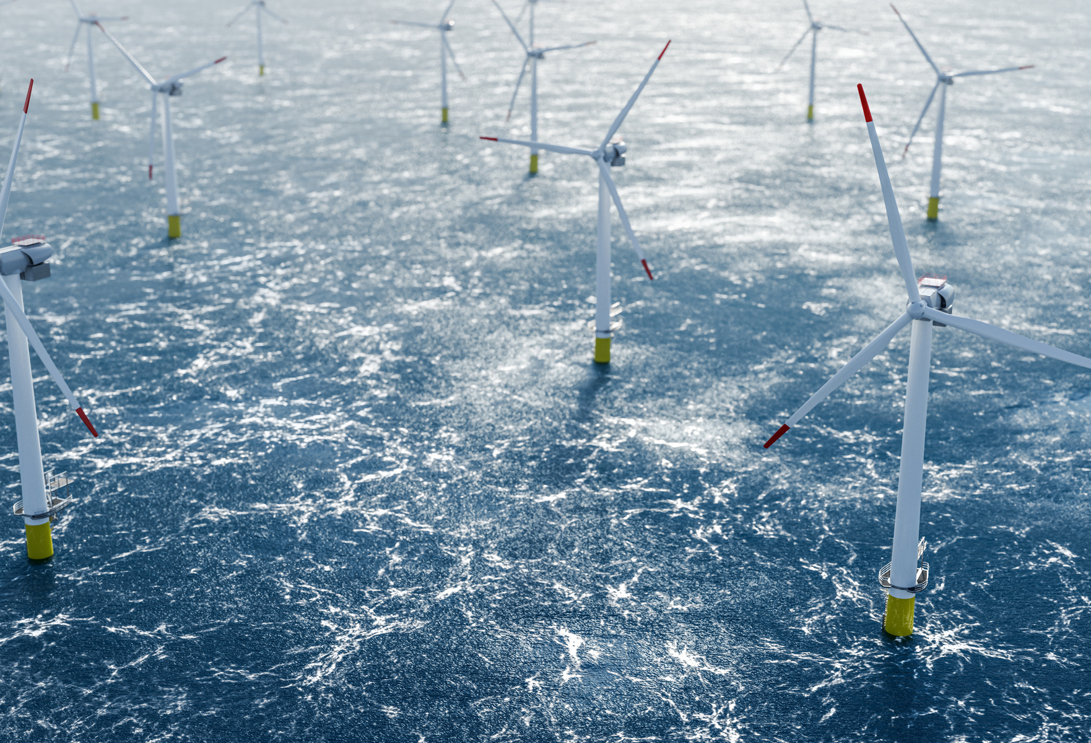
DEPENDENCIES
08
RENEWABLE ENERGY
  Ocean energy
  Environmental impacts
09
NEW MEDICINES
  Marine biodiversity
  Drug discovery
10
THE INTERNET
  Undersea cables
  Vulnerability

Slide 9
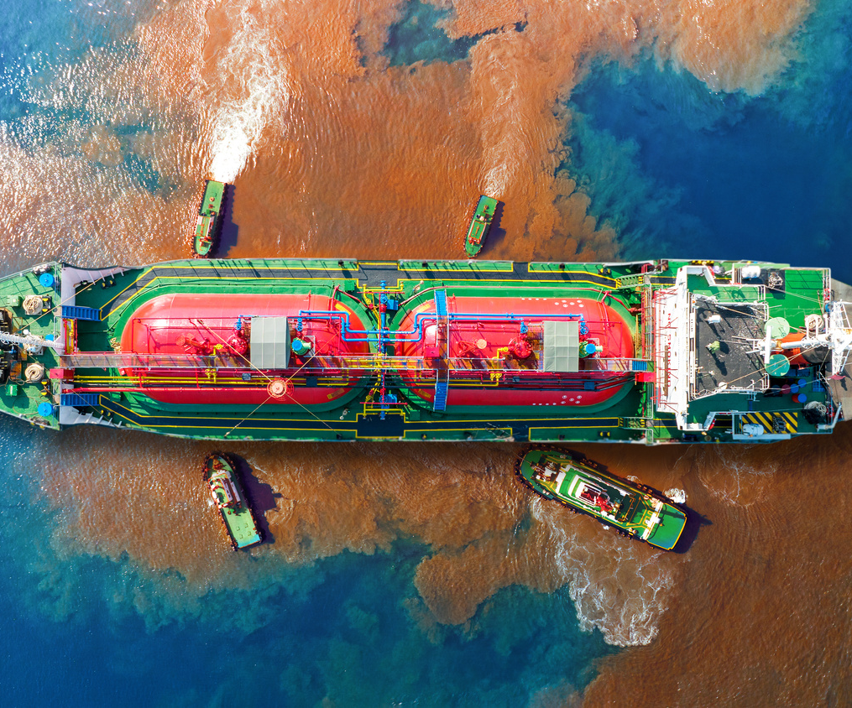
HOW HUMANS IMPACT THE OCEAN
  Emissions​
  Land use and agriculture​
  Chemicals including pharmaceuticals​
  Sewage​
  Plastic​
  Noise​
  Shipping​
  Construction
  Road and mining run-off

Slide 10
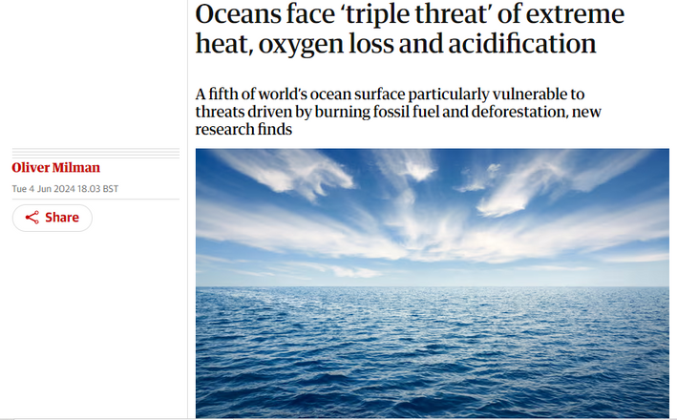
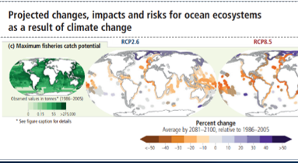
THE RESULT & TRAJECTORY
  Acidification, warming, low O2 levels​
  Reduction in primary production​
  Reduced CO2 sequestration​
  Impact on global fisheries

Slide 11
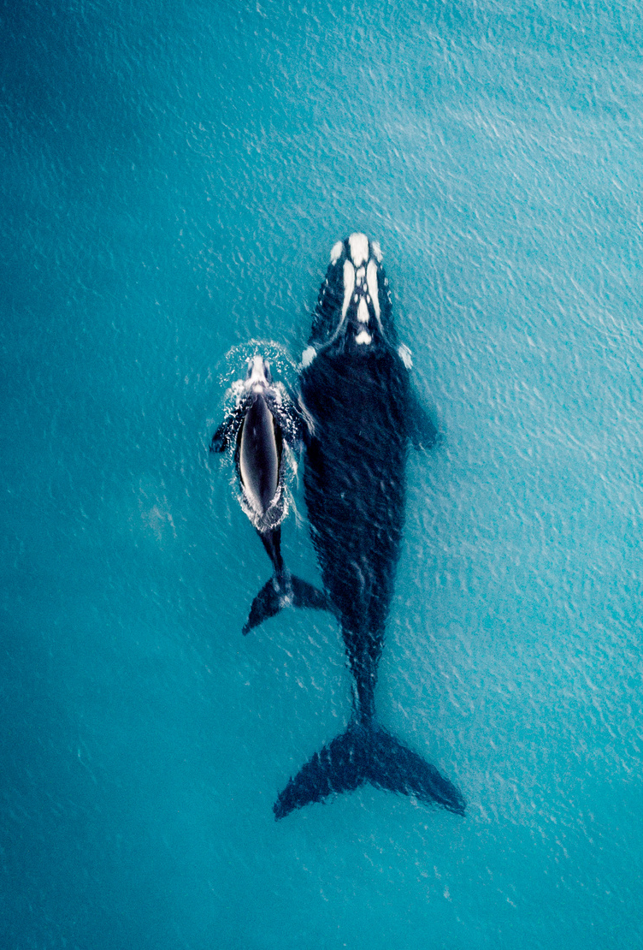
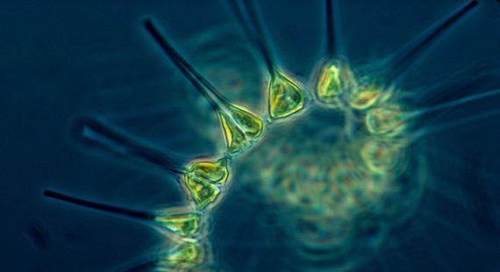
“By absorbing carbon, phytoplankton are our greatest ally in combatting climate change”
Sir David Attenborough 2021

Slide 12
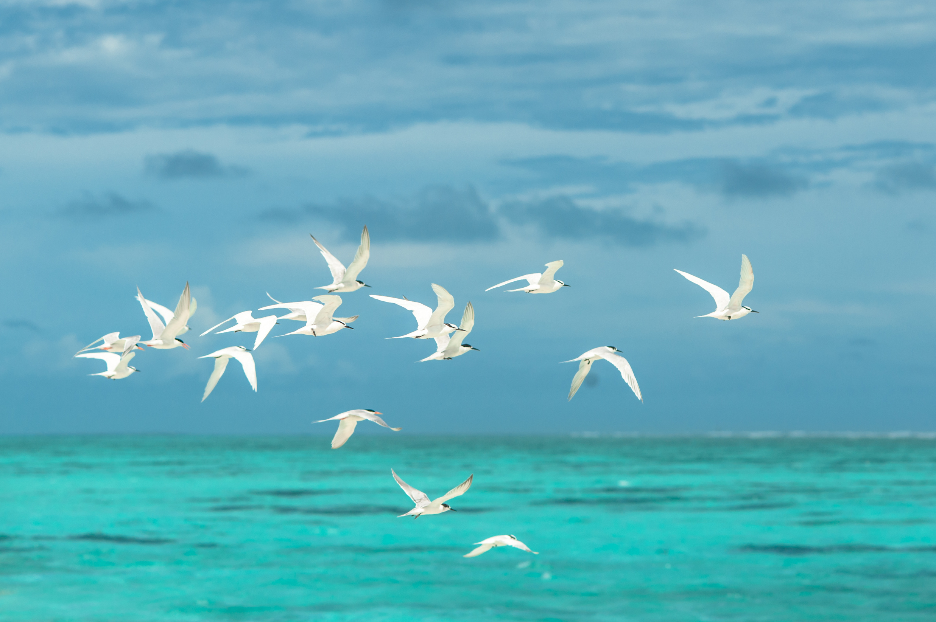

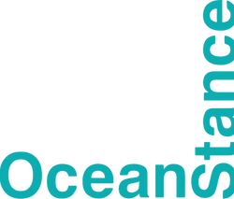
CONTACT DETAILS
Website
Email Address
www.oceanstance.com
action@oceanstance.com

